Slide 1
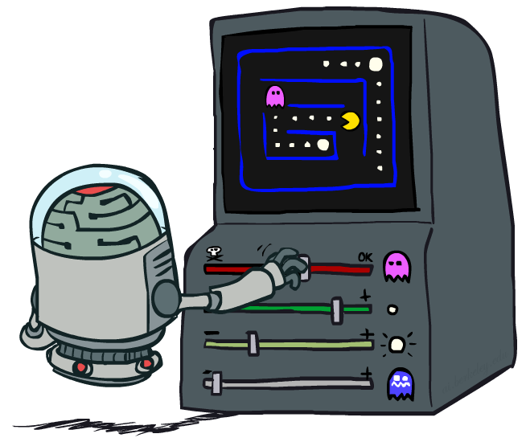
Reinforcement Learning 2
Slides courtesy of Dan Klein and Pieter Abbeel – University of California, Berkeley
[These slides were created by Dan Klein and Pieter Abbeel for CS188 Intro to AI at UC Berkeley. All CS188 materials are available at http://ai.berkeley.edu.]
Notes:
Please retain proper attribution and the reference to ai.berkeley.edu. Thanks!

Slide 2

Review: Reinforcement Learning
We still assume an MDP:
A set of states s ∈ S
A set of actions (per state) A
A model T(s,a,s’)
A reward function R(s,a,s’)
Still looking for a policy π(s)
New twist: don’t know T or R, so must try out actions
Big idea: Compute all averages over T using sample outcomes

Slide 3
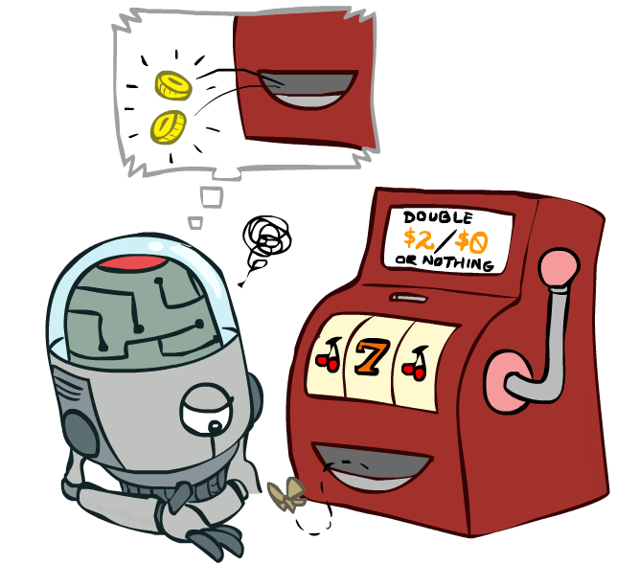
Review: Model-Free Learning
Notes:
When we left of last time we were starting to talk about model free learning.
In model free learning we don't construct a model of the transition function.
Instead, we take actions and every time we take an action we compare what we thought was going to happen to what actually did happen.
Whenever something is better or worse than what we expected we adjust our values up and down.
So what we track in a model free approach is the values of interest themselves not the transition functions or the rewards.

Slide 4
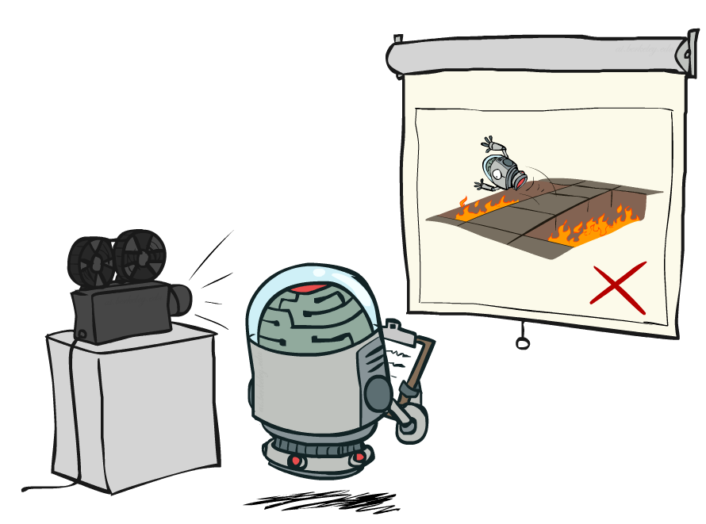
Review: Passive Reinforcement Learning
Notes:
In passive reinforcement learning, someone else chooses the policy. And we observe what happens.
The passive case is this simplified task. We're not going to try to figure out how to act optimally.
We're going try to figure out essentially what policy evaluation did.
The input is a fixed policy. We want to evaluate it.

Slide 5

Review: Passive Reinforcement Learning
Simplified task: policy evaluation
Input: a fixed policy π(s)
You don’t know the transitions T(s,a,s’)
You don’t know the rewards R(s,a,s’)
Goal: learn the state values
In this case:
Learner is “along for the ride”
No choice about what actions to take
Just execute the policy and learn from experience
This is NOT offline planning! You actually take actions in the world.

Slide 6
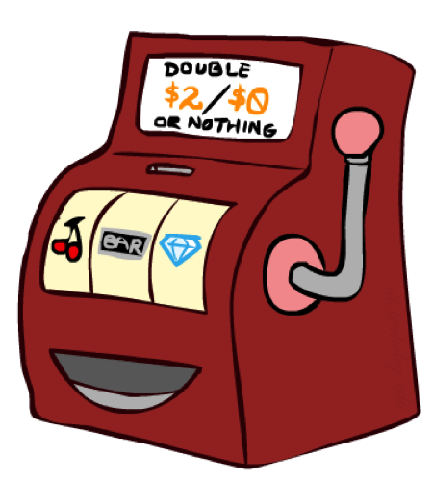
Review: Direct Evaluation
Goal: Compute values for each state under π
Idea: Average together observed sample values
Act according to π
Every time you visit a state, write down what the sum of discounted rewards turned out to be
Average those samples
This is called direct evaluation

Slide 7
Review: Example: Direct Evaluation
Input Policy π
Observed Episodes (Training)
Output Values
Episode 1
Episode 2
 | A
B | C | D
 | E
 | A
B | C | D
 | E
B, east, C, -1
C, east, D, -1
D, exit, x, +10
B, east, C, -1
C, east, D, -1
D, exit, x, +10
-10
+8
+4
+10
Episode 3
Episode 4
-2
E, north, C, -1
C, east, D, -1
D, exit, x, +10
E, north, C, -1
C, east, A, -1
A, exit, x, -10
Assume: γ = 1
Notes:
We’re given an input policy
We just want to evaluate it.
What utility did I receive from B? Not -1. That was the intentions reward. I want to compute the utility, which is from B until the end. So +8.
Write down what happened.
Why 4 for C? 9 + 9 + 9 - 11 = 16/4 = 4

Slide 8
Review: Problems with Direct Evaluation
What’s good about direct evaluation?
It’s easy to understand
It doesn’t require any knowledge of T, R
It eventually computes the correct average values, using just sample transitions
What bad about it?
It wastes information about state connections
Each state must be learned separately
So, it takes a long time to learn
Output Values
 | A
B | C | D
 | E
-10
+8
+4
+10
-2
If B and E both go to C under this policy, how can their values be different?
Notes:
One thing that’s bad about this is that the state connections aren’t effectively taken into account. For example, going from state B to state C has an expected reward of +8, but going from state E to state C has an expected reward of -2. But they are both crossing through the same state? Their values really shouldn’t be this different. So we might want to assign different values to each state with a better algorithm that via direct evaluation.

Slide 9

Why Not Use Policy Evaluation?
s
Simplified Bellman updates calculate V for a fixed policy:
Each round, replace V with a one-step-look-ahead layer over V
This approach fully exploited the connections between the states
Unfortunately, we need T and R to do it!
Key question: how can we do this update to V without knowing T and R?
In other words, how to we take a weighted average without knowing the weights?
π(s)
s, π(s)
s, π(s),s’
s’
Notes:
We already had an algorithm for assigning values to states with a fixed policy. It was called Policy Evaluation. It successfully exploited the connections between states. Here’s how we did it. [re-do the equation again]
Unfortunate this requires that we have a model of T and of R in order to compute the policy evaluation, but we don’t have those in model free learning. Could we do it without knowing T and R? In other words, how to we take a weighted average without knowing the weights?

Slide 10
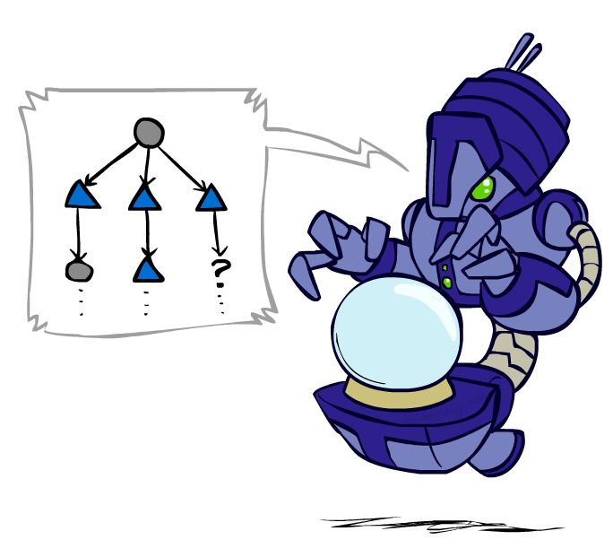
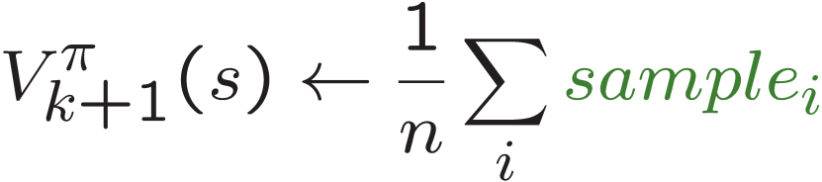
Sample-Based Policy Evaluation?
We want to improve our estimate of V by computing these averages:
Idea: Take samples of outcomes s’ (by doing the action!) and average
s
π(s)
s, π(s)
s, π(s),s’
s₁'
s₂'
s'
s₃'
Almost! But we can’t rewind time to get sample after sample from state s.
Notes:
Here’s an idea. How about we do a sample-based policy evaluation? Just like before, when I was trying to compute the ages of the students in the course, I could take a sample and then average them.
Here’s how it might be work…
At state S, we follow the action of our fixed policy, and then we probabilistically arrive in some state s’. We get a reward for being in that state, plus our discounted V(s’) – which we draw from our look up table. We know that our V(s’) estimate is going to be inaccurate but, but that’s OK.
Then we again draw another sample at state S, following our fixed policy, see which s’ gets returned, and what reward we get from going to that S’.
We do this again and again, and then we can get an averaged estimate of the rewards at this state using the samples, without ever having an explicit model of theTransition function.
What’s wrong with this?
We don’t get to do lots of actions from state s! We don’t get to rewind and re-do it to get multiple observations.
We need to be satisfied with the ONE sample that we get.

Slide 11
Temporal Difference Learning
Big idea: learn from every experience!
Update V(s) each time we experience a transition (s, a, s’, r)
Likely outcomes s’ will contribute updates more often
Temporal difference learning of values
Policy still fixed, still doing evaluation!
Move values toward value of whatever successor occurs: running average
s
π(s)
s, π(s)
s’
Sample of V(s):
Update to V(s):
Same update:
Notes:
That’s the big idea from temporal difference learning. We learn from EVERY experience.
The reason this is called temporal difference learning is because we compare our current estimate of a value with what we actually see.
Let’s look at how this idea works. First, we get a sample. It looks like how we started out last time. We get a sample by making a move from S according to our fixed policy Pi. We then probabilistically arrive in a state S’, and get an observation of the reward. We can then add our estimated of the discounted future reward from S’.
However, in the next step, things start to change. We’re not going to draw another sample. We’re going to use this one sample to update V(s) for this policy pi. How do we do that with just one sample? How do we take the average of just one thing, without wiping out what we learned already?
What we do, is we keep around our learned value so far and then we incorporate the new thing we learned with some weight ALPHA. This is called interpolation.
Here’s one way of writing the update. (Write on board).
I can also write this via algorithmic manipulation as thins. (Write on board).

Slide 12
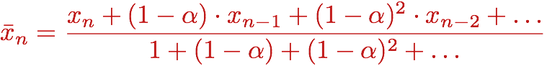
Exponential Moving Average
Exponential moving average
The running interpolation update:
Makes recent samples more important:
Forgets about the past (distant past values were wrong anyway)
Decreasing learning rate (alpha) can give converging averages
Notes:
When we are updating our estimates of V via interpolation with alpha, we are taking an exponential moving average.
New things have more weight. In the case where alpha=1, what happens? New things have ALL of the weight.
If I unroll this, you can see that older things have less value because of the exponention. 1-alpha is going to be is less than 1. In previous time steps that means its raised to a power, and therefore the weight of the previous sample is much lower.
So we forget about the past. But that’s OK. Since the things that we were averaging is the instantaneous reward WHICH IS COMPLETELY CORRECT, and our estimate of the future reward WHICH WAS INITIALLY VERY BAD. But as we update that estimate, it gets better and better. So it actually makes total sense that we want to give greater weight to more recent samples, since they are more accurate.
Decreasing the learning rate can lead to you to converge to the correct averages. There’s an art to it. We’ll come back to that later.

Slide 13
Example: Temporal Difference Learning
States
Observed Transitions
B, east, C, -2
C, east, D, -2
 | A
B | C | D
 | E
 | 0
0 | 0 | 8
 | 0
 | 0
-1 | 0 | 8
 | 0
 | 0
-1 | 3 | 8
 | 0
Assume: γ = 1, α = 1/2
Notes:
Work through this on the board.

Slide 14
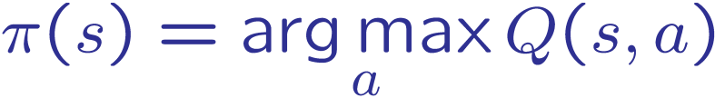
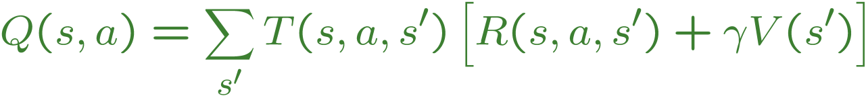
Problems with TD Value Learning
TD value leaning is a model-free way to do policy evaluation, mimicking Bellman updates with running sample averages
However, if we want to turn values into a (new) policy, we’re sunk:
Idea: learn Q-values, not values
Makes action selection model-free too!
s
a
s, a
s,a,s’
s’
Notes:
Temporal Difference value learning is a model-free way of doing Bellman updates, in effect. We’re able to do it without taking the transition function into account. We just let the sample frequency do what we want to.
However, this is not going to work for the case of Active Reinforcement Learning, where we want to both run a policy and update it by transforming it into a new policy. Why is that? Well, what have we got? We’ve got a big table telling us for every state what its value is, that’ is a big table with V(s) values. The problem is that if we want to turn the values into a new policy, which is hopefully better than the old one, we’re in trouble. We know how to do that by doing 1-step of expectimax. But the problem is that requires the Transition function estimates as well.
So, the new idea that we’re going to explore is learning Q-values instead of values. This is a crucial concept in reinforcement learning. Learning Q-values makes action selection into a model-free process as well. We just look at the Q-values and pick whichever one is best.

Slide 15
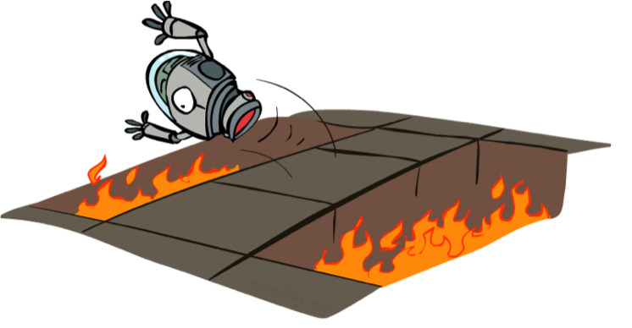
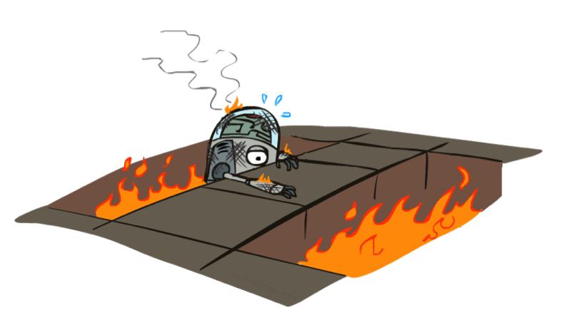
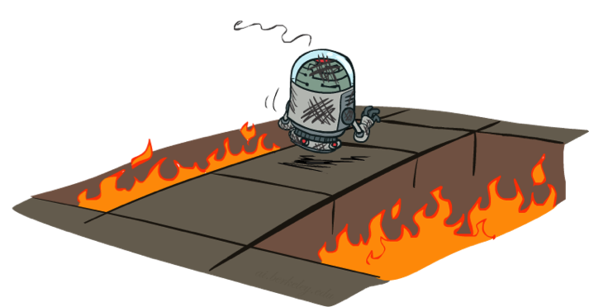
Active Reinforcement Learning
Notes:
In active reinforcement learning, you have to try things. Even if they turn out to be bad. You probably won’t try it again, but you’ve learned. This is a notion called regret. We’ll learn more about that later.

Slide 16
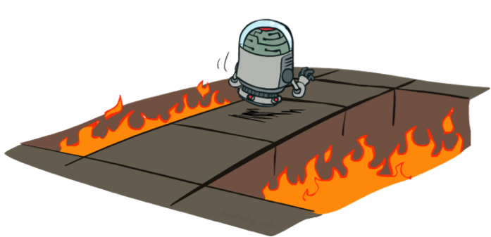
Active Reinforcement Learning
Full reinforcement learning: optimal policies (like value iteration)
You don’t know the transitions T(s,a,s’)
You don’t know the rewards R(s,a,s’)
You choose the actions now
Goal: learn the optimal policy / values
In this case:
Learner makes choices!
Fundamental tradeoff: exploration vs. exploitation
This is NOT offline planning! You actually take actions in the world and find out what happens…
Notes:
Previously we were talking about passive reinforcement learning, where the agent followed a fixed policy. In full reinforcement learning, we want the agent to be able to select its own policy, and hopefully converge towards an optimal policy.
We still don’t know the probabilities or the rewards. But we can pick it out now.
So, we’re going to let the learner start to make choices instead of following a fixed policy.

Slide 17
Detour: Q-Value Iteration
Value iteration: find successive (depth-limited) values
Start with V₀(s) = 0, which we know is right
Given V_{k}, calculate the depth k+1 values for all states:
But Q-values are more useful, so compute them instead
Start with Q₀(s,a) = 0, which we know is right
Given Q_{k}, calculate the depth k+1 q-values for all q-states:
Notes:
Let’s take a detour back to the algorithm that we had for finding optimal values.
We had value iteration. It started with a vector of zeros, and then computed new approximations to the values, which converged to the optimal values.
How did that work? What we would do is take our current values, (V_k) and do a layer of expectimax, taking those into account. Then we compute the utility of the instanteous reward plus our V_k future reward estimate. Then we weight it appropriately.
We can’t do this with a sample. Why not. The only thing we can do with samples is compute averages of things, and this is not an average. Why isn’t this an average? It’s because of the max. We don’t know of a way of using samples to maximize.
The big breakthrough – probably the biggest breakthrough in reinforcement learning in a decade, was to shift down the tree by half a layer. Then we can write down a version of Value Iteration that works with Q-values.
So let’s think about what that would be. Let’s think about starting for Q-values at some depth k. If we had Q_k+1(s, a). SO here it is. It’s almost like the other equations, but it’s shifted by half a layer. The critical difference is that with this equation, the thing in front is an average. We can do this with sampling.

Slide 18
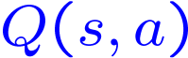
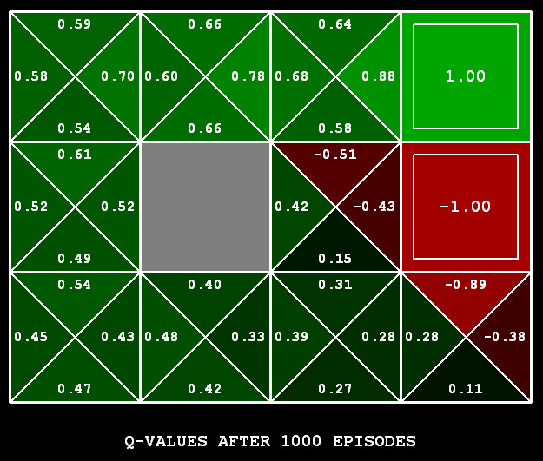
Q-Learning
Q-Learning: sample-based Q-value iteration
Learn Q(s,a) values as you go
Receive a sample (s,a,s’,r)
Consider your old estimate:
Consider your new sample estimate:
Incorporate the new estimate into a running average:
[Demo: Q-learning – gridworld (L10D2)]
[Demo: Q-learning – crawler (L10D3)]
Notes:
In Q-learning, we’re going to replace the Q-value with a one-step look ahead sample.
This will allow us to do it as we go, and therefore do active Reinforcement Learning without having a model.
Every time we are in a state S, we’ll take an action A. We’ll learn how good S A is.
We’ll maintain a table that looks like this.
We’re in S, we do A, and we get a sample (s, a, s’, r). That tells us something about the world.
Sample tells us the instantaneous reward, R(s, a, s’), plus the old estimate of Q(s’, a’) – discounted by gamma.
We can incorporate this into a running average like this:
(Write the equation).
This is q-learning. It is awesome.

Slide 19
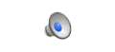
Video of Demo Q-Learning -- Gridworld
Notes:
Here’s a demo of how it works.

Slide 20

Q-Learning Properties
Amazing result: Q-learning converges to optimal policy -- even if you’re acting suboptimally!
This is called off-policy learning
Caveats:
You have to explore enough
You have to eventually make the learning rate
small enough
… but not decrease it too quickly
Basically, in the limit, it doesn’t matter how you select actions (!)
Notes:
There is an amazing result here. Q-learning converges to OPTIMAL policy, even if you’re NOT FOLLOWING IT!!!!
This is called off-policy learning (you don’t have to follow the perfect policy in order to learn it).
There are a few caveats. Basically, in the limit, it doesn’t matter how you select actions – you can jump of the cliff a lot, but you’ll still be able to learn the optimal policy.

Slide 21
Review: Reinforcement Learning
We still assume an MDP:
A set of states s ∈ S
A set of actions (per state) A
A model T(s,a,s’)
A reward function R(s,a,s’)
Still looking for a policy π(s)
New twist: don’t know T or R, so must try out actions
Big idea: Compute all averages over T using sample outcomes

Slide 22
The Story So Far: MDPs and RL
Known MDP: Offline Solution
Goal Technique
Compute V*, Q*, π* Value / policy iteration
Evaluate a fixed policy π Policy evaluation
Unknown MDP: Model-Based
Unknown MDP: Model-Free
Goal Technique
Compute V*, Q*, π* VI/PI on approx. MDP
Evaluate a fixed policy π PE on approx. MDP
Goal Technique
Compute V*, Q*, π* Q-learning
Evaluate a fixed policy π Value Learning
Notes:
By now, you’ve seen a lot of things that qualify as Bellman equations. Equations that relate the value one state to the value one state later, after one action.
You’ve seen q-values in term of q-values. You’ve seen some with pis, and some with stars. By now, you may in Bellman equation overload.
All these things, when you aren’t use to them, look the same. And the good news, is that when you are used to them, they still all look the same. They’re all just expeictmax written out in different ways. There’s a max when I’m acting optimally. Sometimes there’s a pi when I’m fixed to a policy. Anything we can do with values, we can do either with values or q-values since it’s just a matter of where we start our recurrence in expectimax. Do I start at a state, which evaluates a state, or a q-state which evaluates an action?
For MDPs, we know the probabilities, so we can compute the solutions online. For reinforcement learning, we don’t know the value, so that requires new ways of solving the problem. We’re going to dive into q-learning now.

Slide 23
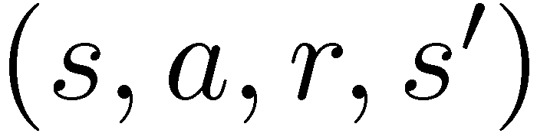
Model-Free Learning
s
Model-free (temporal difference) learning
Experience world through episodes
Update estimates each transition
Over time, updates will mimic Bellman updates
a
s, a
r
s’
a’
s’, a’
s’’
Notes:
What does model free learning mean? The agent experiences the world through a stream of transitions that form episodes. For example, you start in state S, you take an action (forget for a second where we know to take that action), then you land in state s’ you take action a’, you end in state s’’.
Every transition is going to cause you to learn about the world, and improve the world. Over time these updates will mimic Bellman updates.

Slide 24
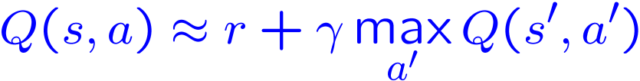
Q-Learning
We’d like to do Q-value updates to each Q-state:
But can’t compute this update without knowing T, R
Instead, compute average as we go
Receive a sample transition (s,a,r,s’)
This sample suggests
But we want to average over results from (s,a) (Why?)
So keep a running average
Notes:
People were held back for decades by staring at value updates. In short, the problem was that they require first doing a max, and we can’t compute that by sampling.
Bye we shouldn’t really be evaluating values anyway. We should be evaluating actions. The value of an action is its Q-value.
So here’s how that works. In this case it’s q-value iteration. If we knew the MDP, we would do it like in equation 1. Now instead of having a max on the outside, we have an average. We know how to do that with sampling. Here’s how….
On the basis of one sample, what can we conculde about the Q-state, <s, a>. We’ve got a reward r, plus the maximum of the future actions, since we assume we’ll continue to act soptimally.
We keep a running average. It constantly maintains Q(s, a). Every time we receive an instaneous sample, we fold it in with weight 1-alpha.

Slide 25
Q-Learning Properties
Amazing result: Q-learning converges to optimal policy -- even if you’re acting suboptimally!
This is called off-policy learning
Caveats:
You have to explore enough
You have to eventually make the learning rate
small enough
… but not decrease it too quickly
Basically, in the limit, it doesn’t matter how you select actions (!)
[Demo: Q-learning – auto – cliff grid (L11D1)]
Notes:
There is an amazing result here. Q-learning converges to OPTIMAL policy, even if you’re NOT FOLLOWING IT!!!!
This is called off-policy learning (you don’t have to follow the perfect policy in order to learn it).
There are a few caveats. Basically, in the limit, it doesn’t matter how you select actions – you can jump of the cliff a lot, but you’ll still be able to learn the optimal policy.

Slide 26
Video of Demo Q-Learning Auto Cliff Grid
Notes:
Here’s another demo that will automatically run q-learning instead of stepping through it.

Slide 27
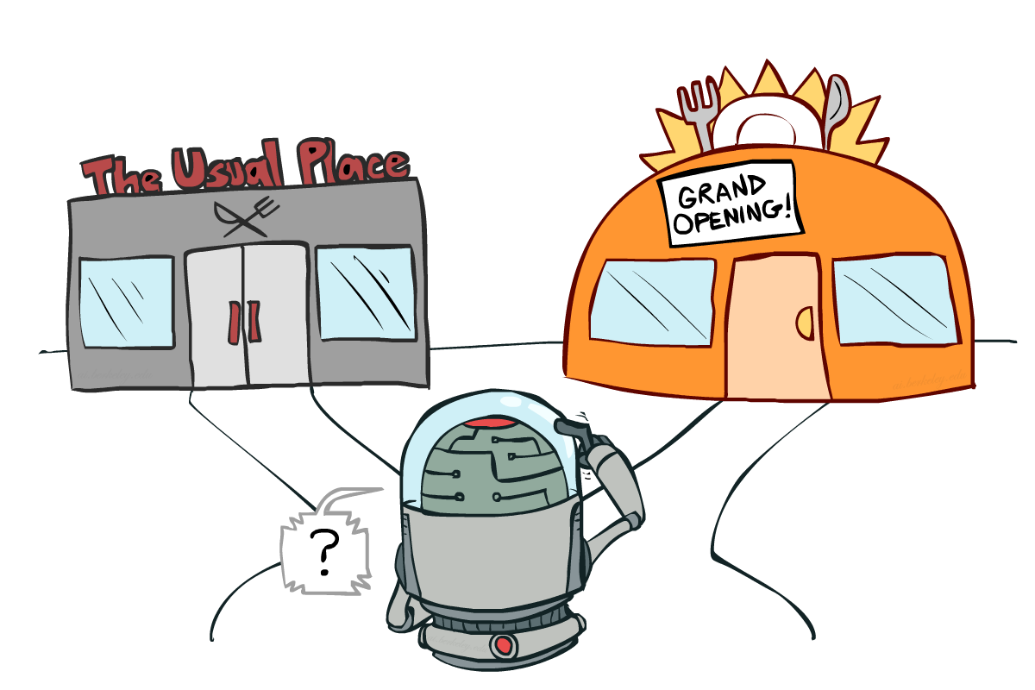
Exploration vs. Exploitation
Notes:
So what does q-learning require in order for us to learn an optimal policy.
It requires that you explore enough,.
One of the most important things in reinforcement learning is an inevitable trade off between exploration and exploitation.
You have to try some stuff. You have to make some mistakes.

Slide 28
Video of Demo Q-learning – Manual Exploration – Bridge Grid

Slide 29

How to Explore?
Several schemes for forcing exploration
Simplest: random actions (ε-greedy)
Every time step, flip a coin
With (small) probability ε, act randomly
With (large) probability 1-ε, act on current policy
Problems with random actions?
You do eventually explore the space, but keep thrashing around once learning is done
One solution: lower ε over time
Another solution: exploration functions
[Demo: Q-learning – manual exploration – bridge grid (L11D2)] [Demo: Q-learning – epsilon-greedy -- crawler (L11D3)]
Notes:
Q-learning didn’t specify how to select actions.
This tells us how to selection actions to allow q-learning to do it’s magic.
A lot of random actions without not much progress.

Slide 30
Video of Demo Q-learning – Epsilon-Greedy – Crawler

Slide 31
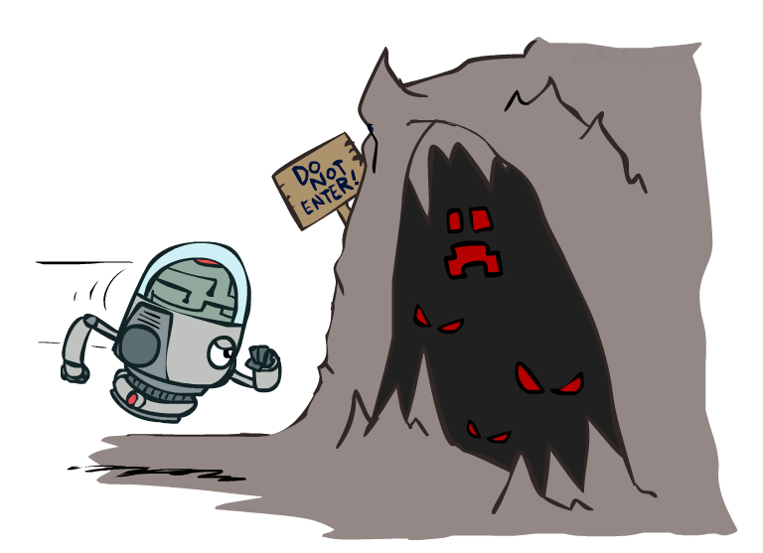
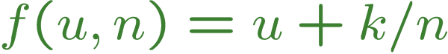
Exploration Functions
When to explore?
Random actions: explore a fixed amount
Better idea: explore areas whose badness is not
(yet) established, eventually stop exploring
Exploration function
Takes a value estimate u and a visit count n, and
returns an optimistic utility, e.g.
Note: this propagates the “bonus” back to states that lead to unknown states as well!
Regular Q-Update:
Modified Q-Update:
[Demo: exploration – Q-learning – crawler – exploration function (L11D4)]
Notes:
k/n decreases over time as we increase the number of samples.

Slide 32
Video of Demo Q-learning – Exploration Function – Crawler

Slide 33
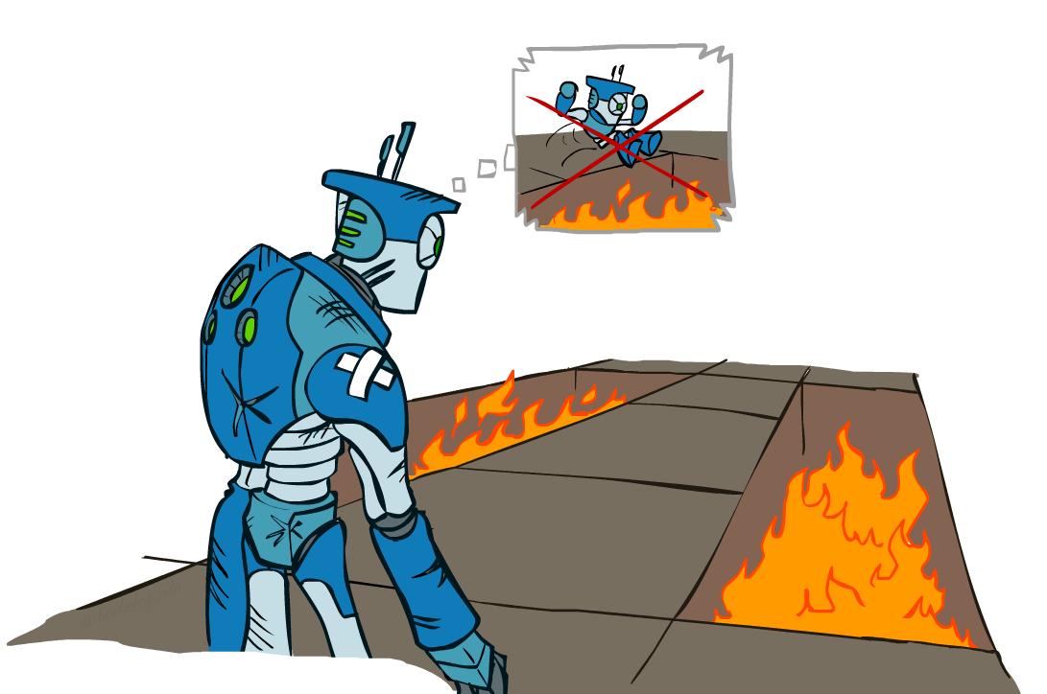
Regret
Even if you learn the optimal policy, you still make mistakes along the way!
Regret is a measure of your total mistake cost: the difference between your (expected) rewards, including youthful suboptimality, and optimal (expected) rewards
Minimizing regret goes beyond learning to be optimal – it requires optimally learning to be optimal
Example: random exploration and exploration functions both end up optimal, but random exploration has higher regret

Slide 34
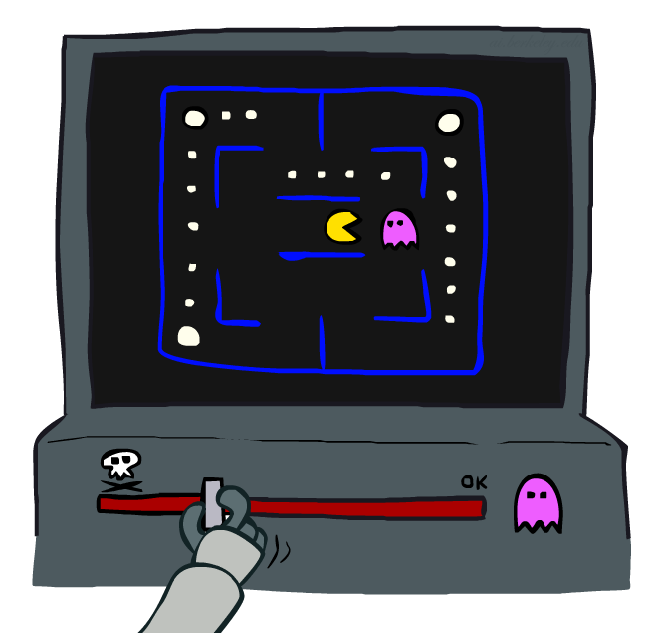
Approximate Q-Learning

Slide 35
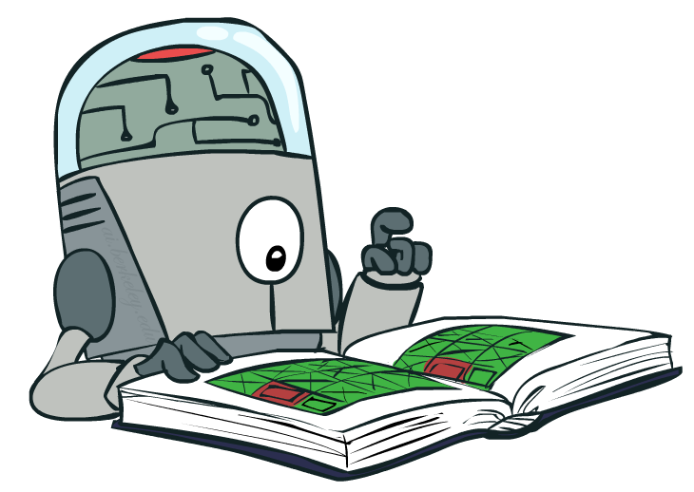
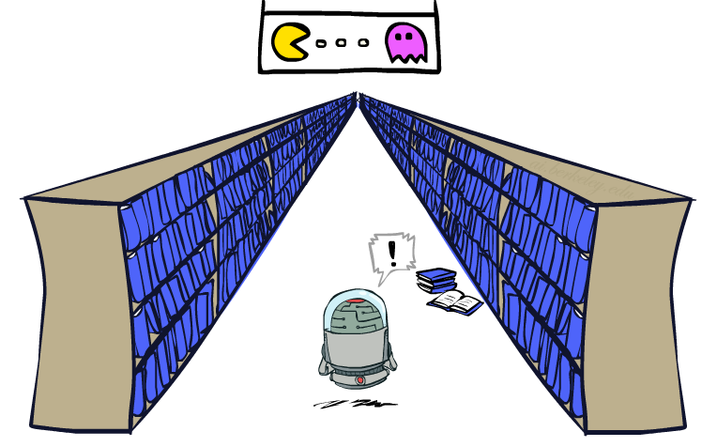
Generalizing Across States
Basic Q-Learning keeps a table of all q-values
In realistic situations, we cannot possibly learn about every single state!
Too many states to visit them all in training
Too many states to hold the q-tables in memory
Instead, we want to generalize:
Learn about some small number of training states from experience
Generalize that experience to new, similar situations
This is a fundamental idea in machine learning, and we’ll see it over and over again
[demo – RL pacman]

Slide 36
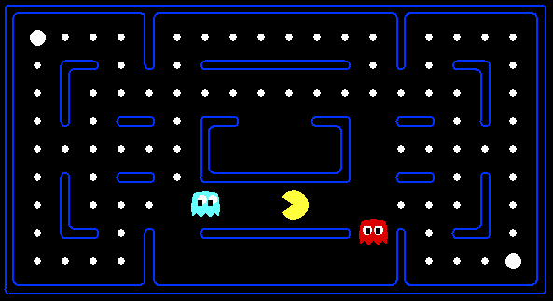
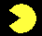


Example: Pacman
Let’s say we discover through experience that this state is bad:
In naïve q-learning, we know nothing about this state:
Or even this one!
[Demo: Q-learning – pacman – tiny – watch all (L11D5)]
[Demo: Q-learning – pacman – tiny – silent train (L11D6)]
[Demo: Q-learning – pacman – tricky – watch all (L11D7)]

Slide 37
Video of Demo Q-Learning Pacman – Tiny – Watch All

Slide 38
Video of Demo Q-Learning Pacman – Tiny – Silent Train

Slide 39
Video of Demo Q-Learning Pacman – Tricky – Watch All

Slide 40
Feature-Based Representations
Solution: describe a state using a vector of features (properties)
Features are functions from states to real numbers (often 0/1) that capture important properties of the state
Example features:
Distance to closest ghost
Distance to closest dot
Number of ghosts
1 / (dist to dot)²
Is Pacman in a tunnel? (0/1)
…… etc.
Is it the exact state on this slide?
Can also describe a q-state (s, a) with features (e.g. action moves closer to food)

Slide 41
Linear Value Functions
Using a feature representation, we can write a q function (or value function) for any state using a few weights:
Advantage: our experience is summed up in a few powerful numbers
Disadvantage: states may share features but actually be very different in value!

Slide 42

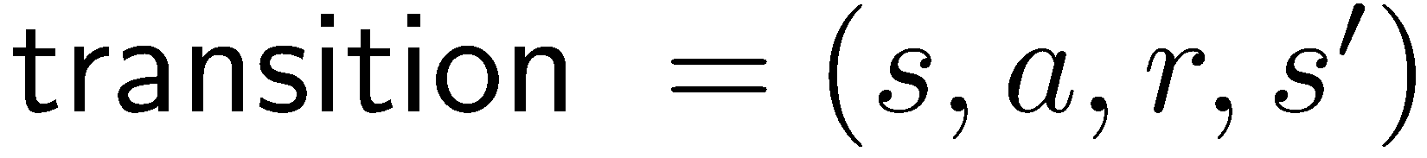
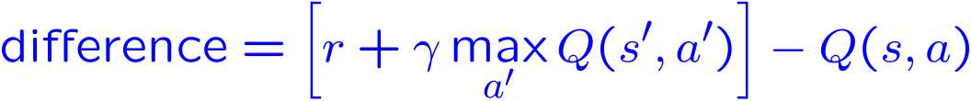
Approximate Q-Learning
Q-learning with linear Q-functions:
Intuitive interpretation:
Adjust weights of active features
E.g., if something unexpectedly bad happens, blame the features that were on: disprefer all states with that state’s features
Formal justification: online least squares
Exact Q’s
Approximate Q’s

Slide 43
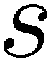
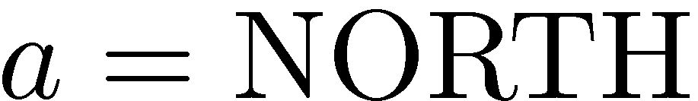
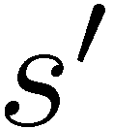
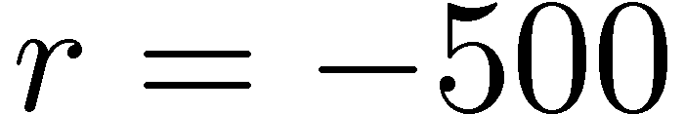
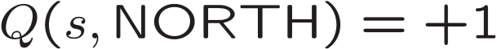
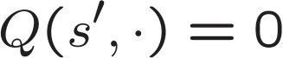
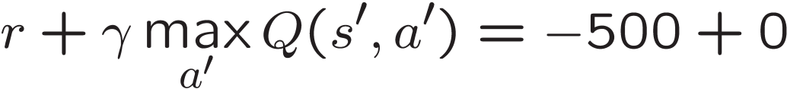
Example: Q-Pacman
[Demo: approximate Q-learning pacman (L11D10)]

Slide 44
Video of Demo Approximate Q-Learning -- Pacman

Slide 45
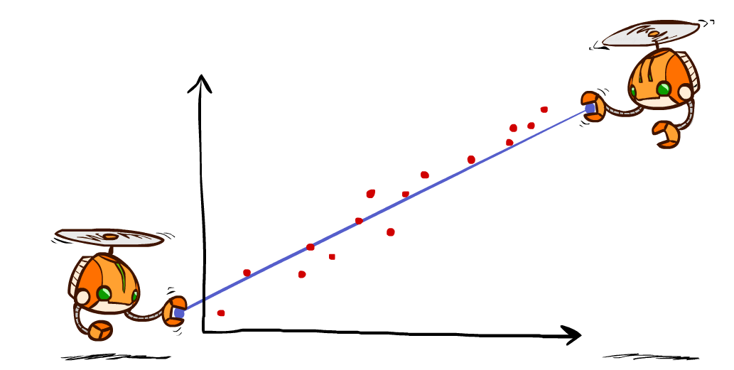
Q-Learning and Least Squares

Slide 46
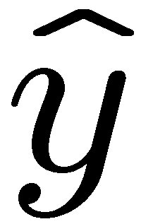
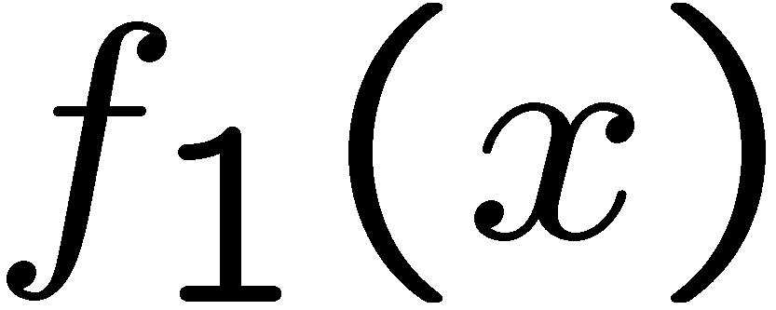
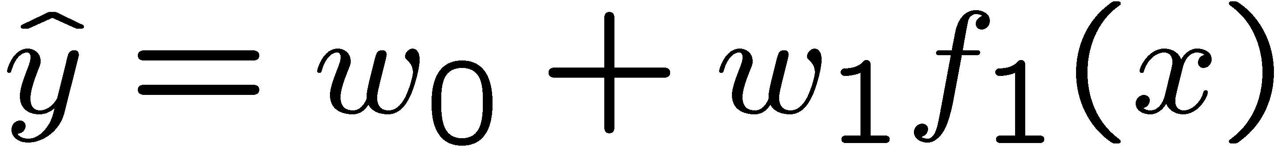
Linear Approximation: Regression*
40
26
24
20
22
20
30
20
40
0
0
20
30
10
20
0
10
0
Prediction:
Prediction:
Notes:
Figure 1: scatter(1:20,10+(1:20)+2*randn(1,20),'k','filled'); a=axis; a(3)=0; axis(a);

Slide 47
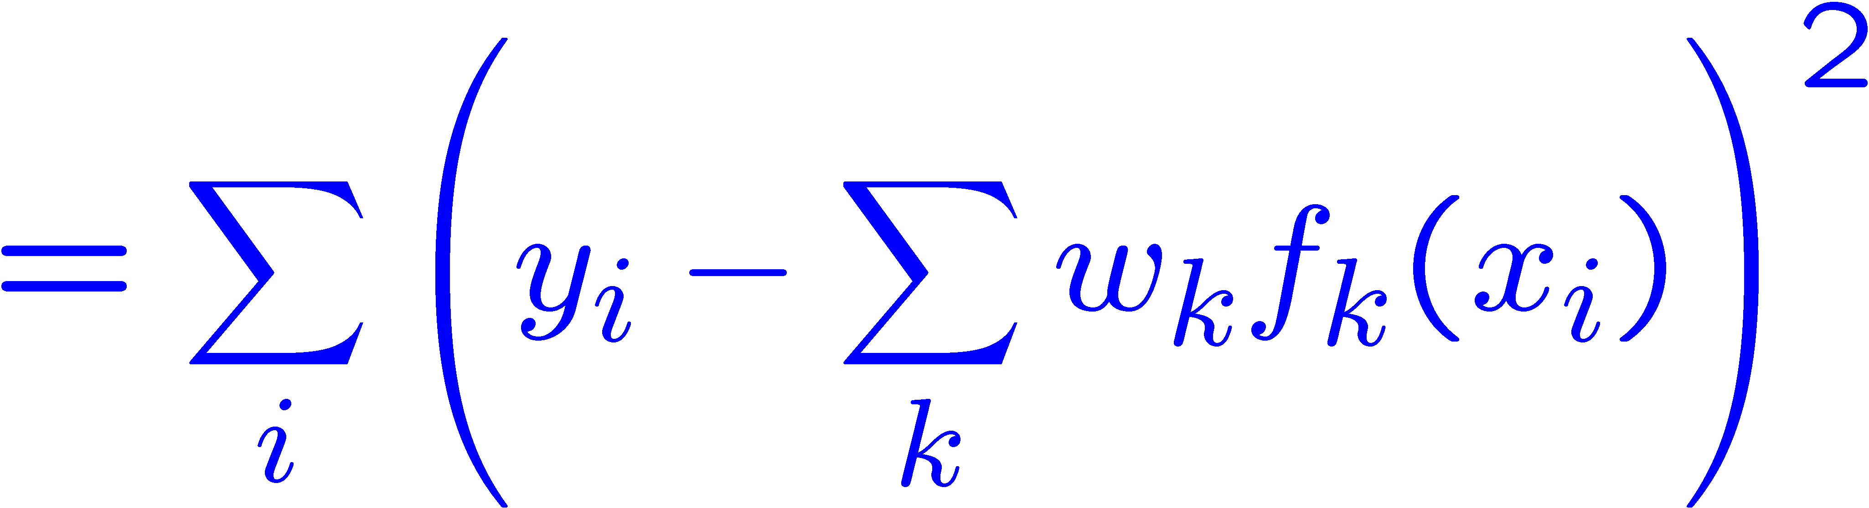
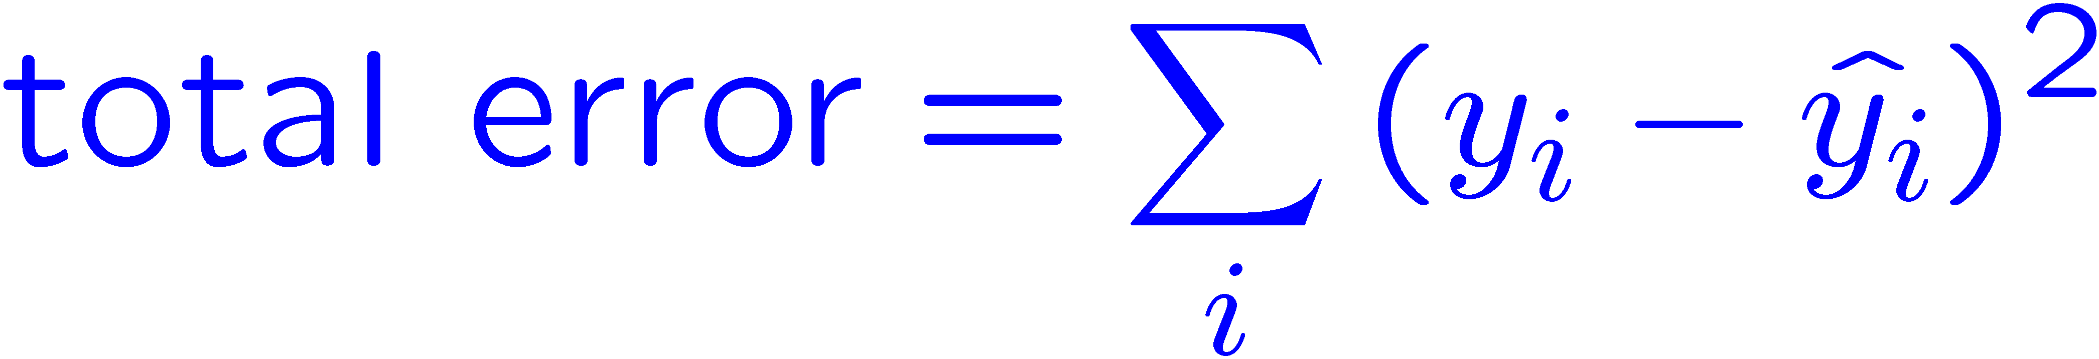
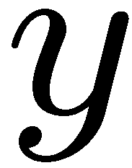
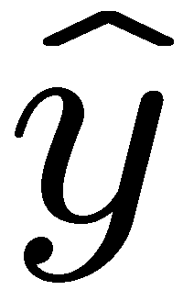

Optimization: Least Squares*
Error or “residual”
Observation
Prediction
0
0
20
Notes:
Figure 1: scatter(1:20,10+(1:20)+2*randn(1,20),'k','filled'); a=axis; a(3)=0; axis(a);

Slide 48
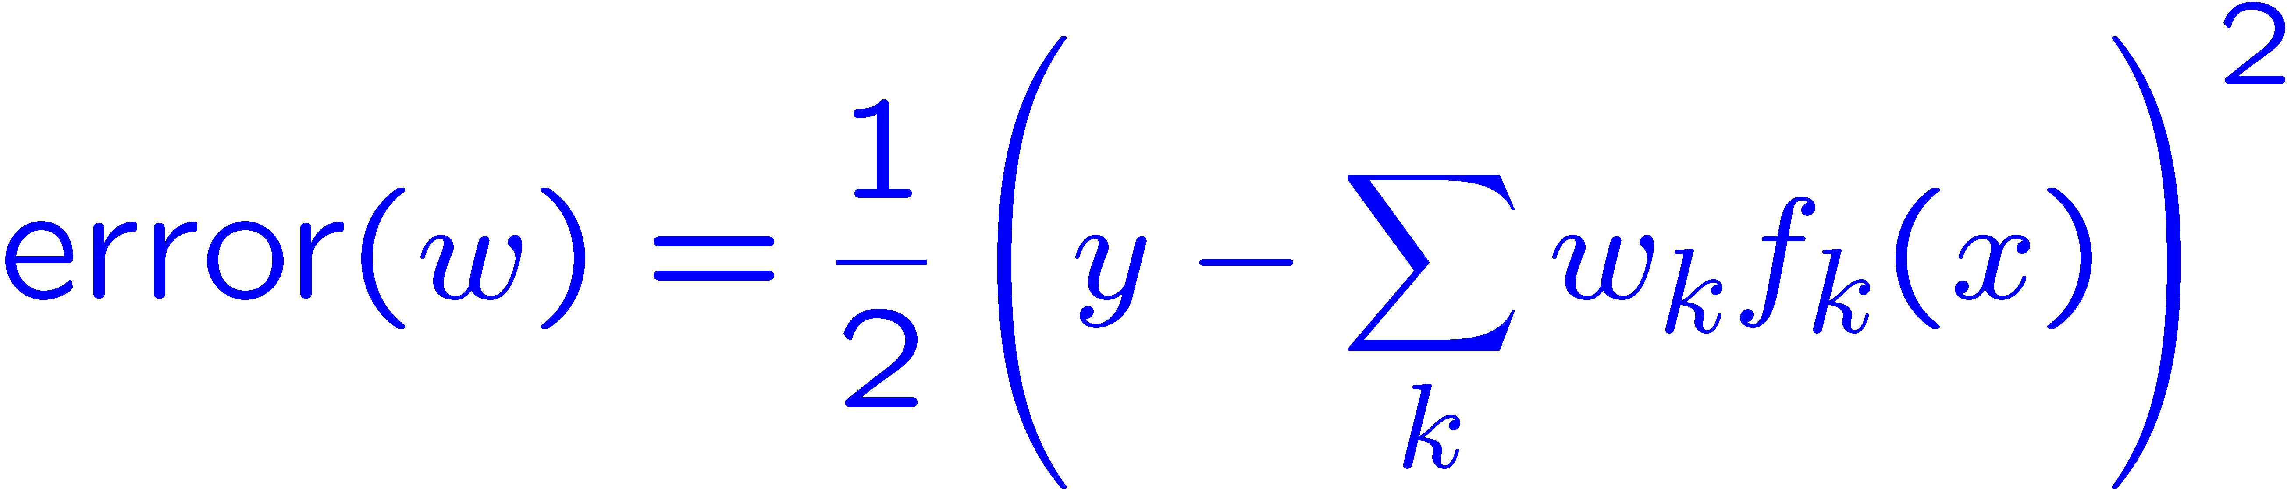
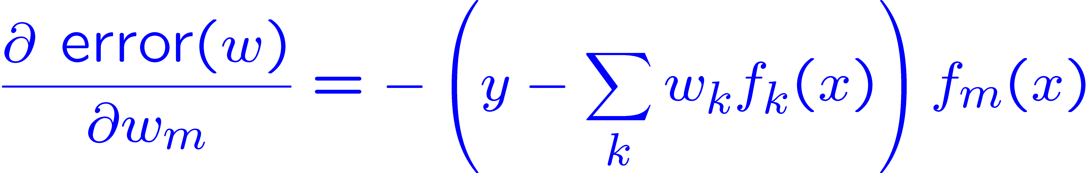
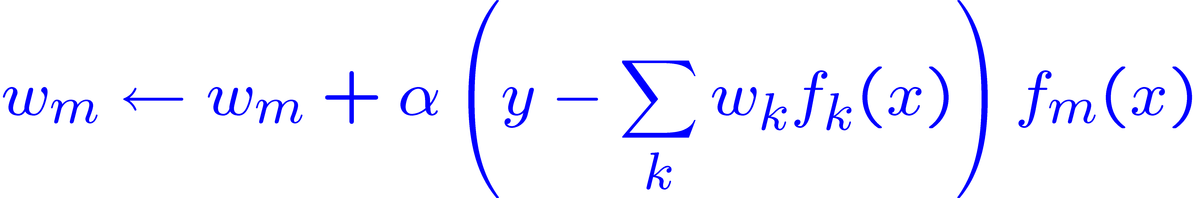
Minimizing Error*
Imagine we had only one point x, with features f(x), target value y, and weights w:
Approximate q update explained:
“target”
“prediction”

Slide 49
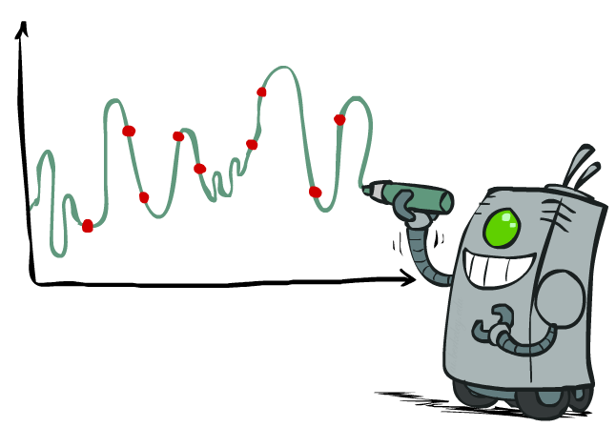
Overfitting: Why Limiting Capacity Can Help*
30
25
20
Degree 15 polynomial
15
10
5
0
-5
-10
-15
0
2
4
6
8
10
12
14
16
18
20

Slide 50
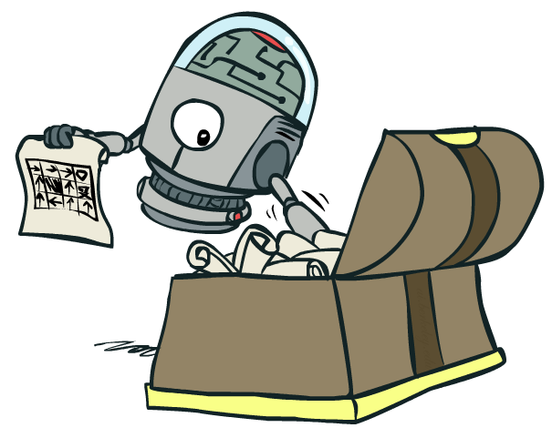
Policy Search

Slide 51
Policy Search
Problem: often the feature-based policies that work well (win games, maximize utilities) aren’t the ones that approximate V / Q best
E.g. your value functions from project 2 were probably horrible estimates of future rewards, but they still produced good decisions
Q-learning’s priority: get Q-values close (modeling)
Action selection priority: get ordering of Q-values right (prediction)
We’ll see this distinction between modeling and prediction again later in the course
Solution: learn policies that maximize rewards, not the values that predict them
Policy search: start with an ok solution (e.g. Q-learning) then fine-tune by hill climbing on feature weights

Slide 52
Policy Search
Simplest policy search:
Start with an initial linear value function or Q-function
Nudge each feature weight up and down and see if your policy is better than before
Problems:
How do we tell the policy got better?
Need to run many sample episodes!
If there are a lot of features, this can be impractical
Better methods exploit lookahead structure, sample wisely, change multiple parameters…

Slide 53
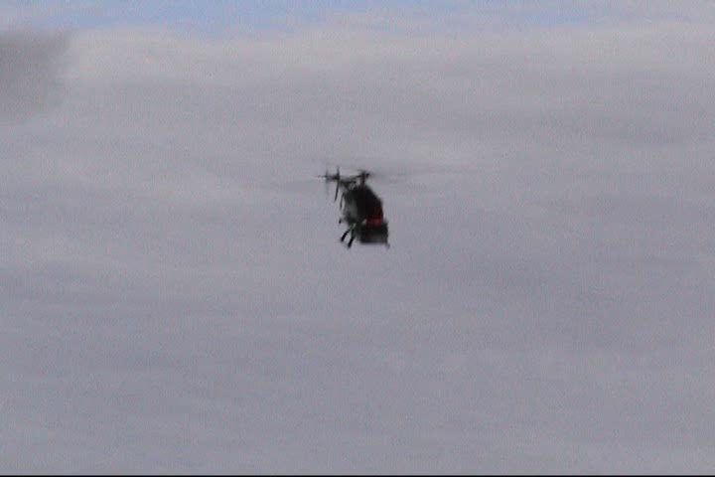
Policy Search
[Andrew Ng]
[Video: HELICOPTER]

